Slide 1
Fixed points are abundant in Boolean gene networks
Chris Viets
MIT Depts. of Physics & Biology

Slide 2
Motivation
How can we model complex gene networks?
What can we infer about the physical properties of these networks from our models?
Dynamic, multivariable system
Simplify using well-characterized properties of graph and networks
Gain insight into system’s properties

Slide 3
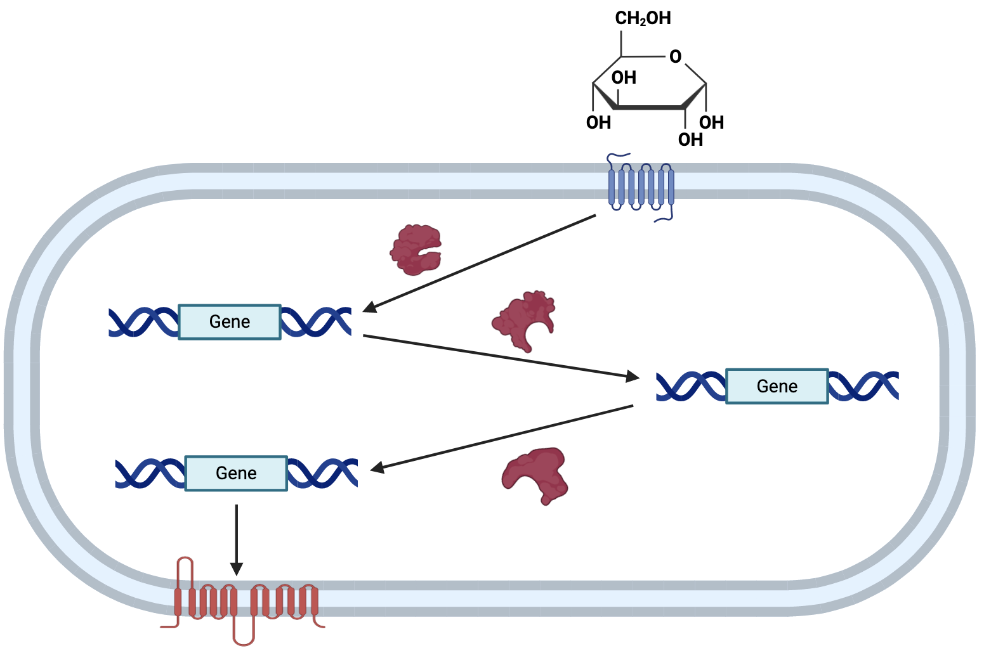
Genes regulate each other based on environmental signals
DNA
mRNA
Protein

Slide 4
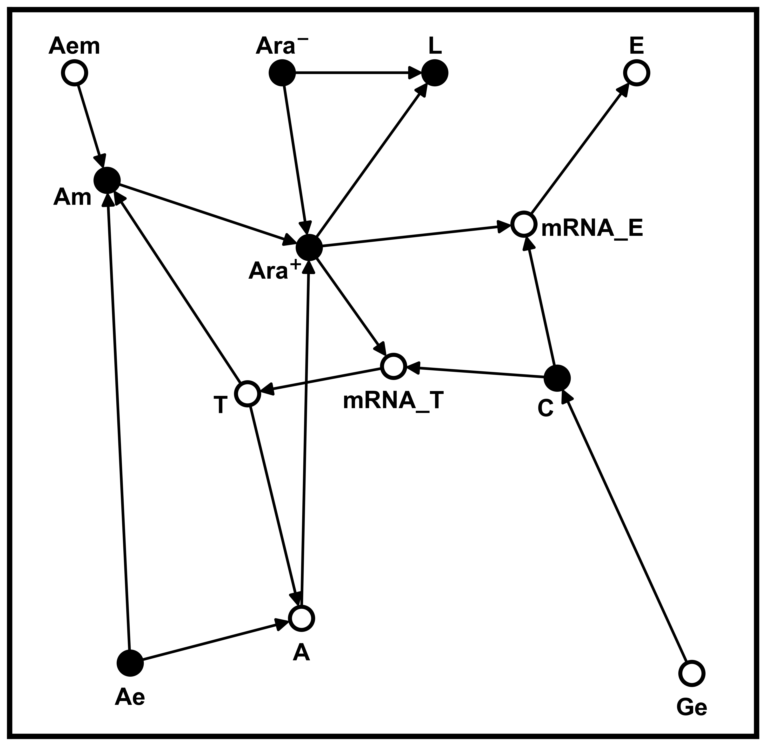
Model gene network as set of Boolean functions
Arabinose metabolism is ON when arabinose AND NOT glucose
mRNA_E = C AND Ara⁺
C = NOT Ge

Slide 5
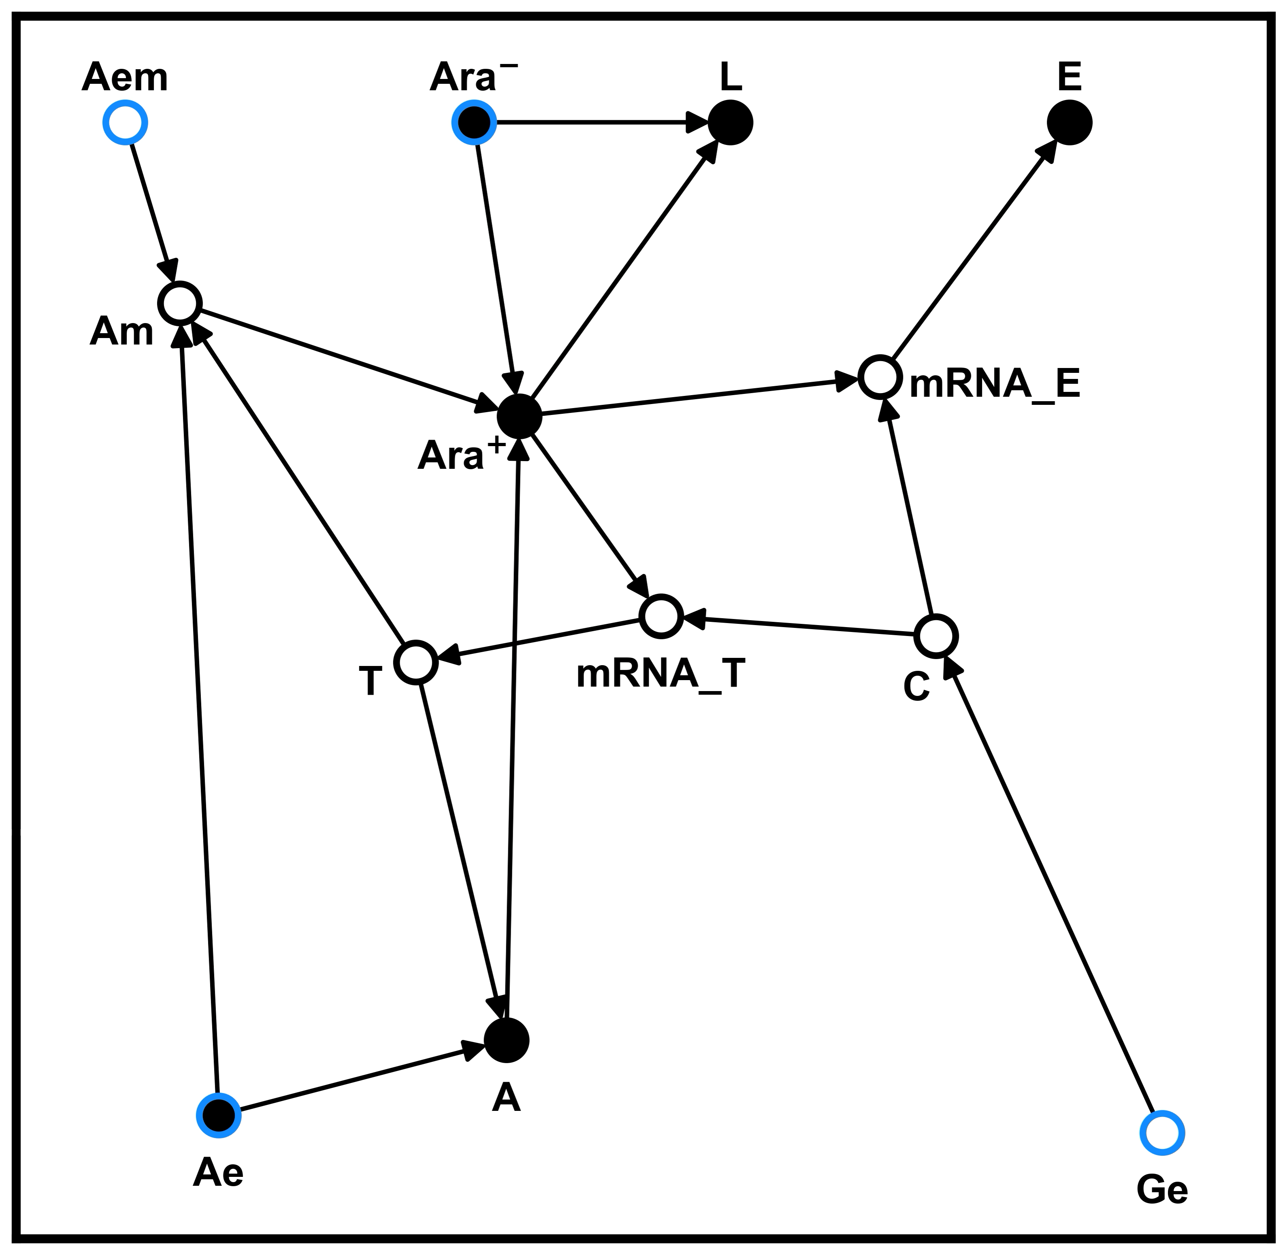
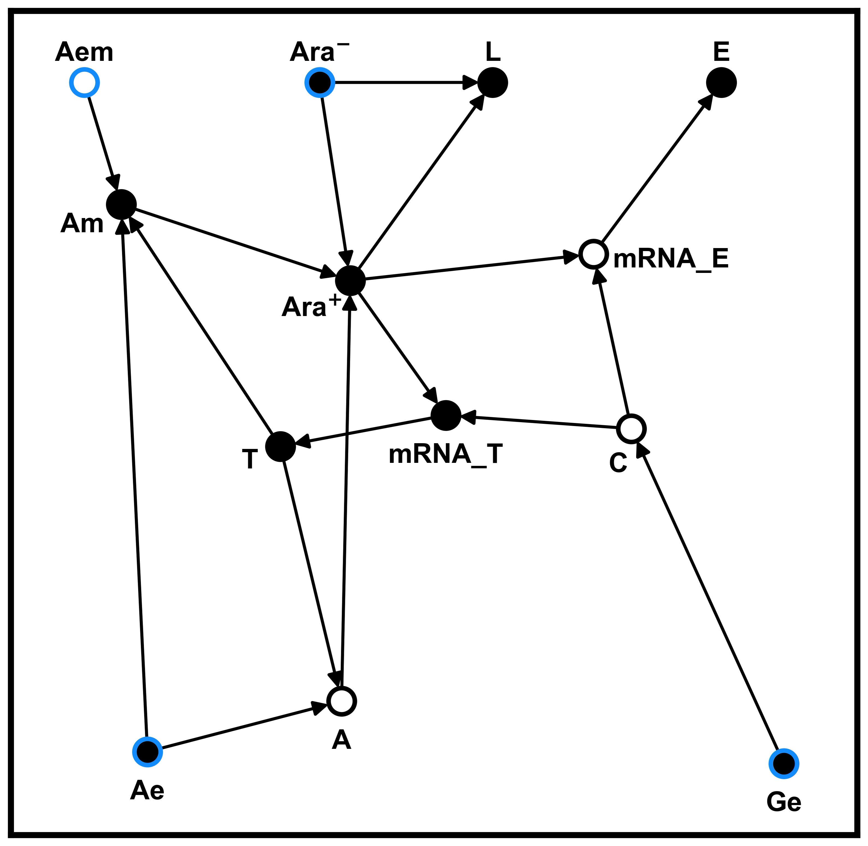
Bacteria use gene networks to metabolize arabinose in absence of glucose
Without glucose
With glucose

Slide 6
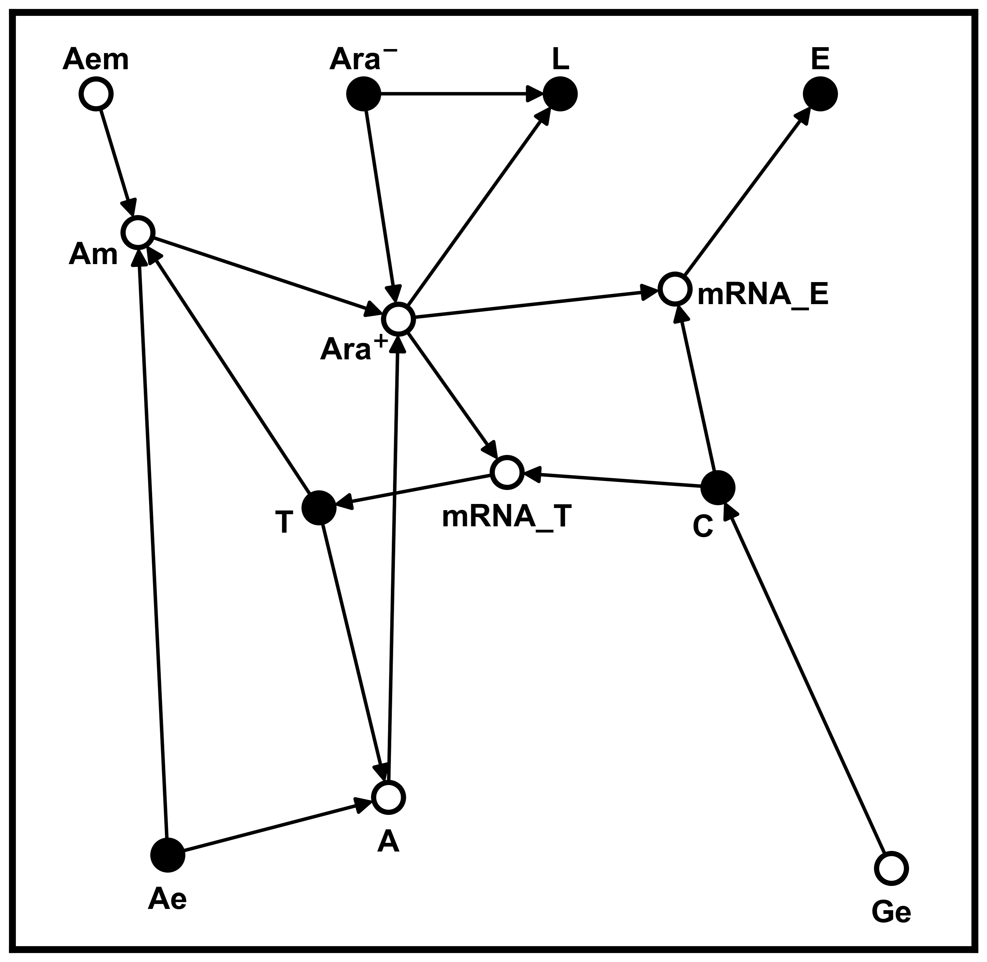
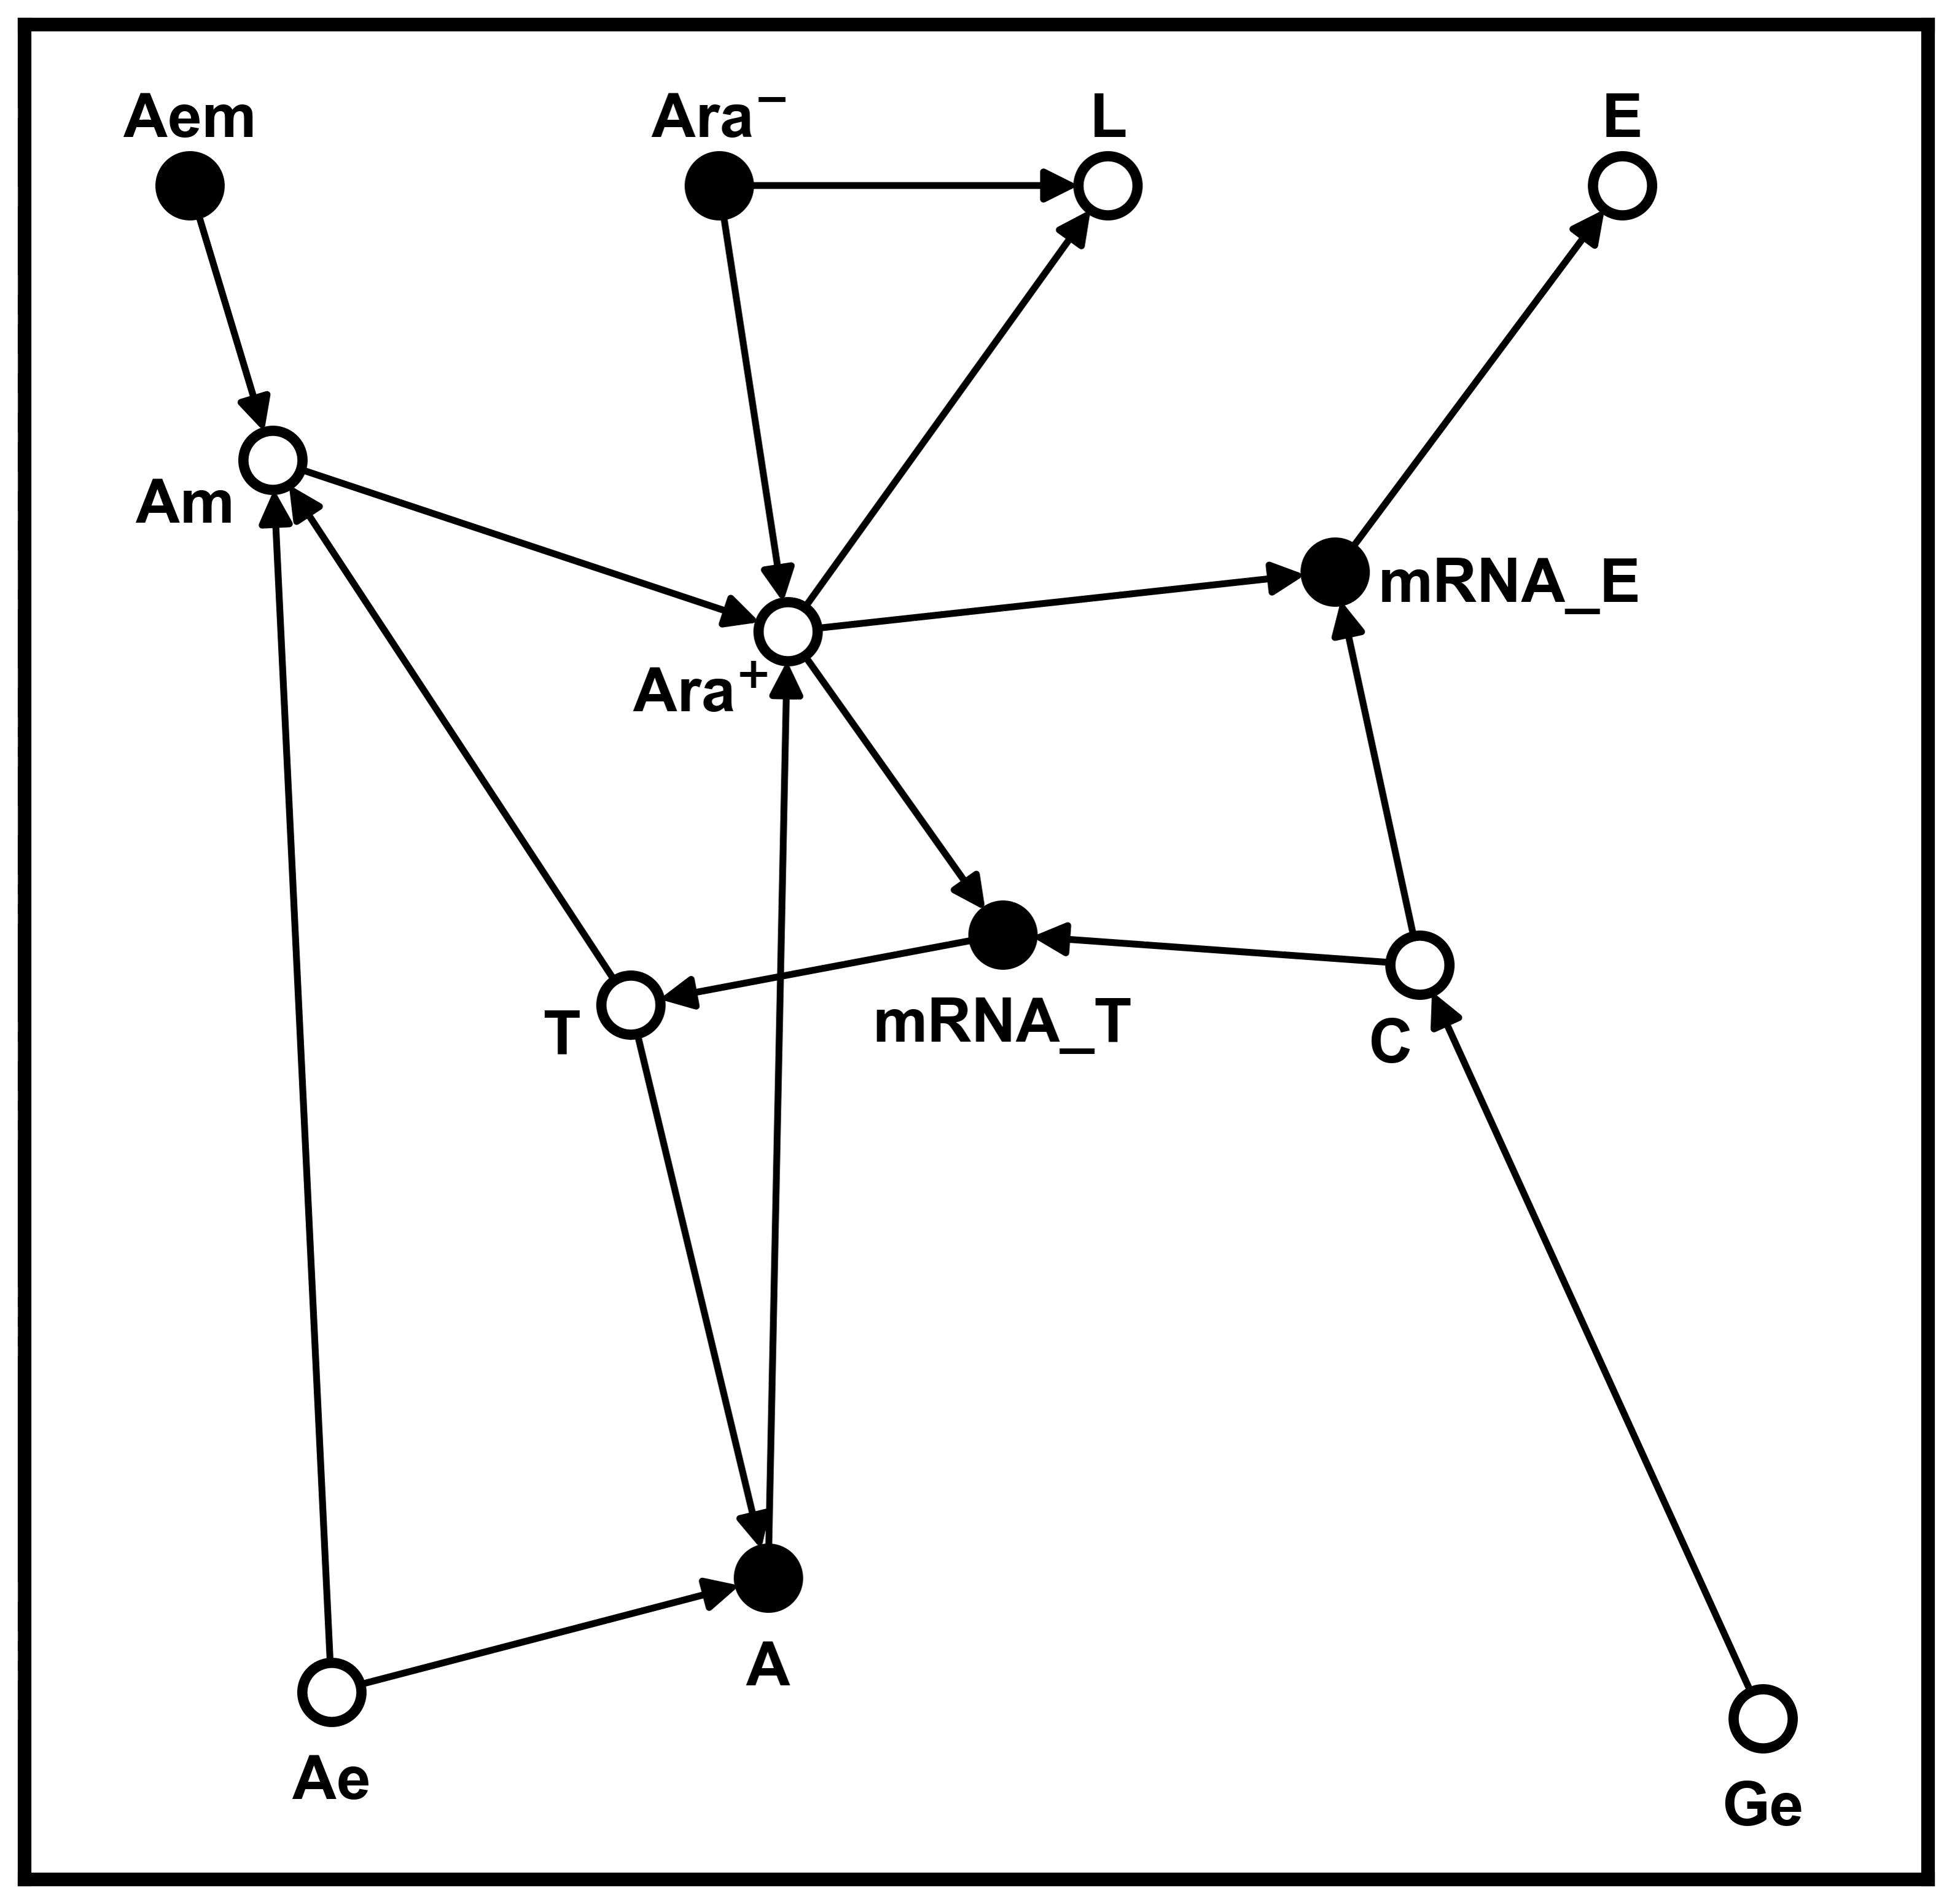
Network stability often depends on choice of initial conditions
Stable fixed point
Oscillating system

Slide 7
Hypothesis: fixed points are overrepresented in gene networks
CellCollective is a database of dozens of gene networks
For each network:
Count fraction of fixed points compared to all attractors (fixed points plus oscillators)
Control group: randomly scramble each network while preserving the number of regulatory interactions at each node
Count fraction of fixed points among all random networks

Slide 8

Generating random networks
Erase all arrows, but record in-degrees and out-degrees at each node
Randomly draw new arrows
Generate random Boolean function at each node

Slide 9
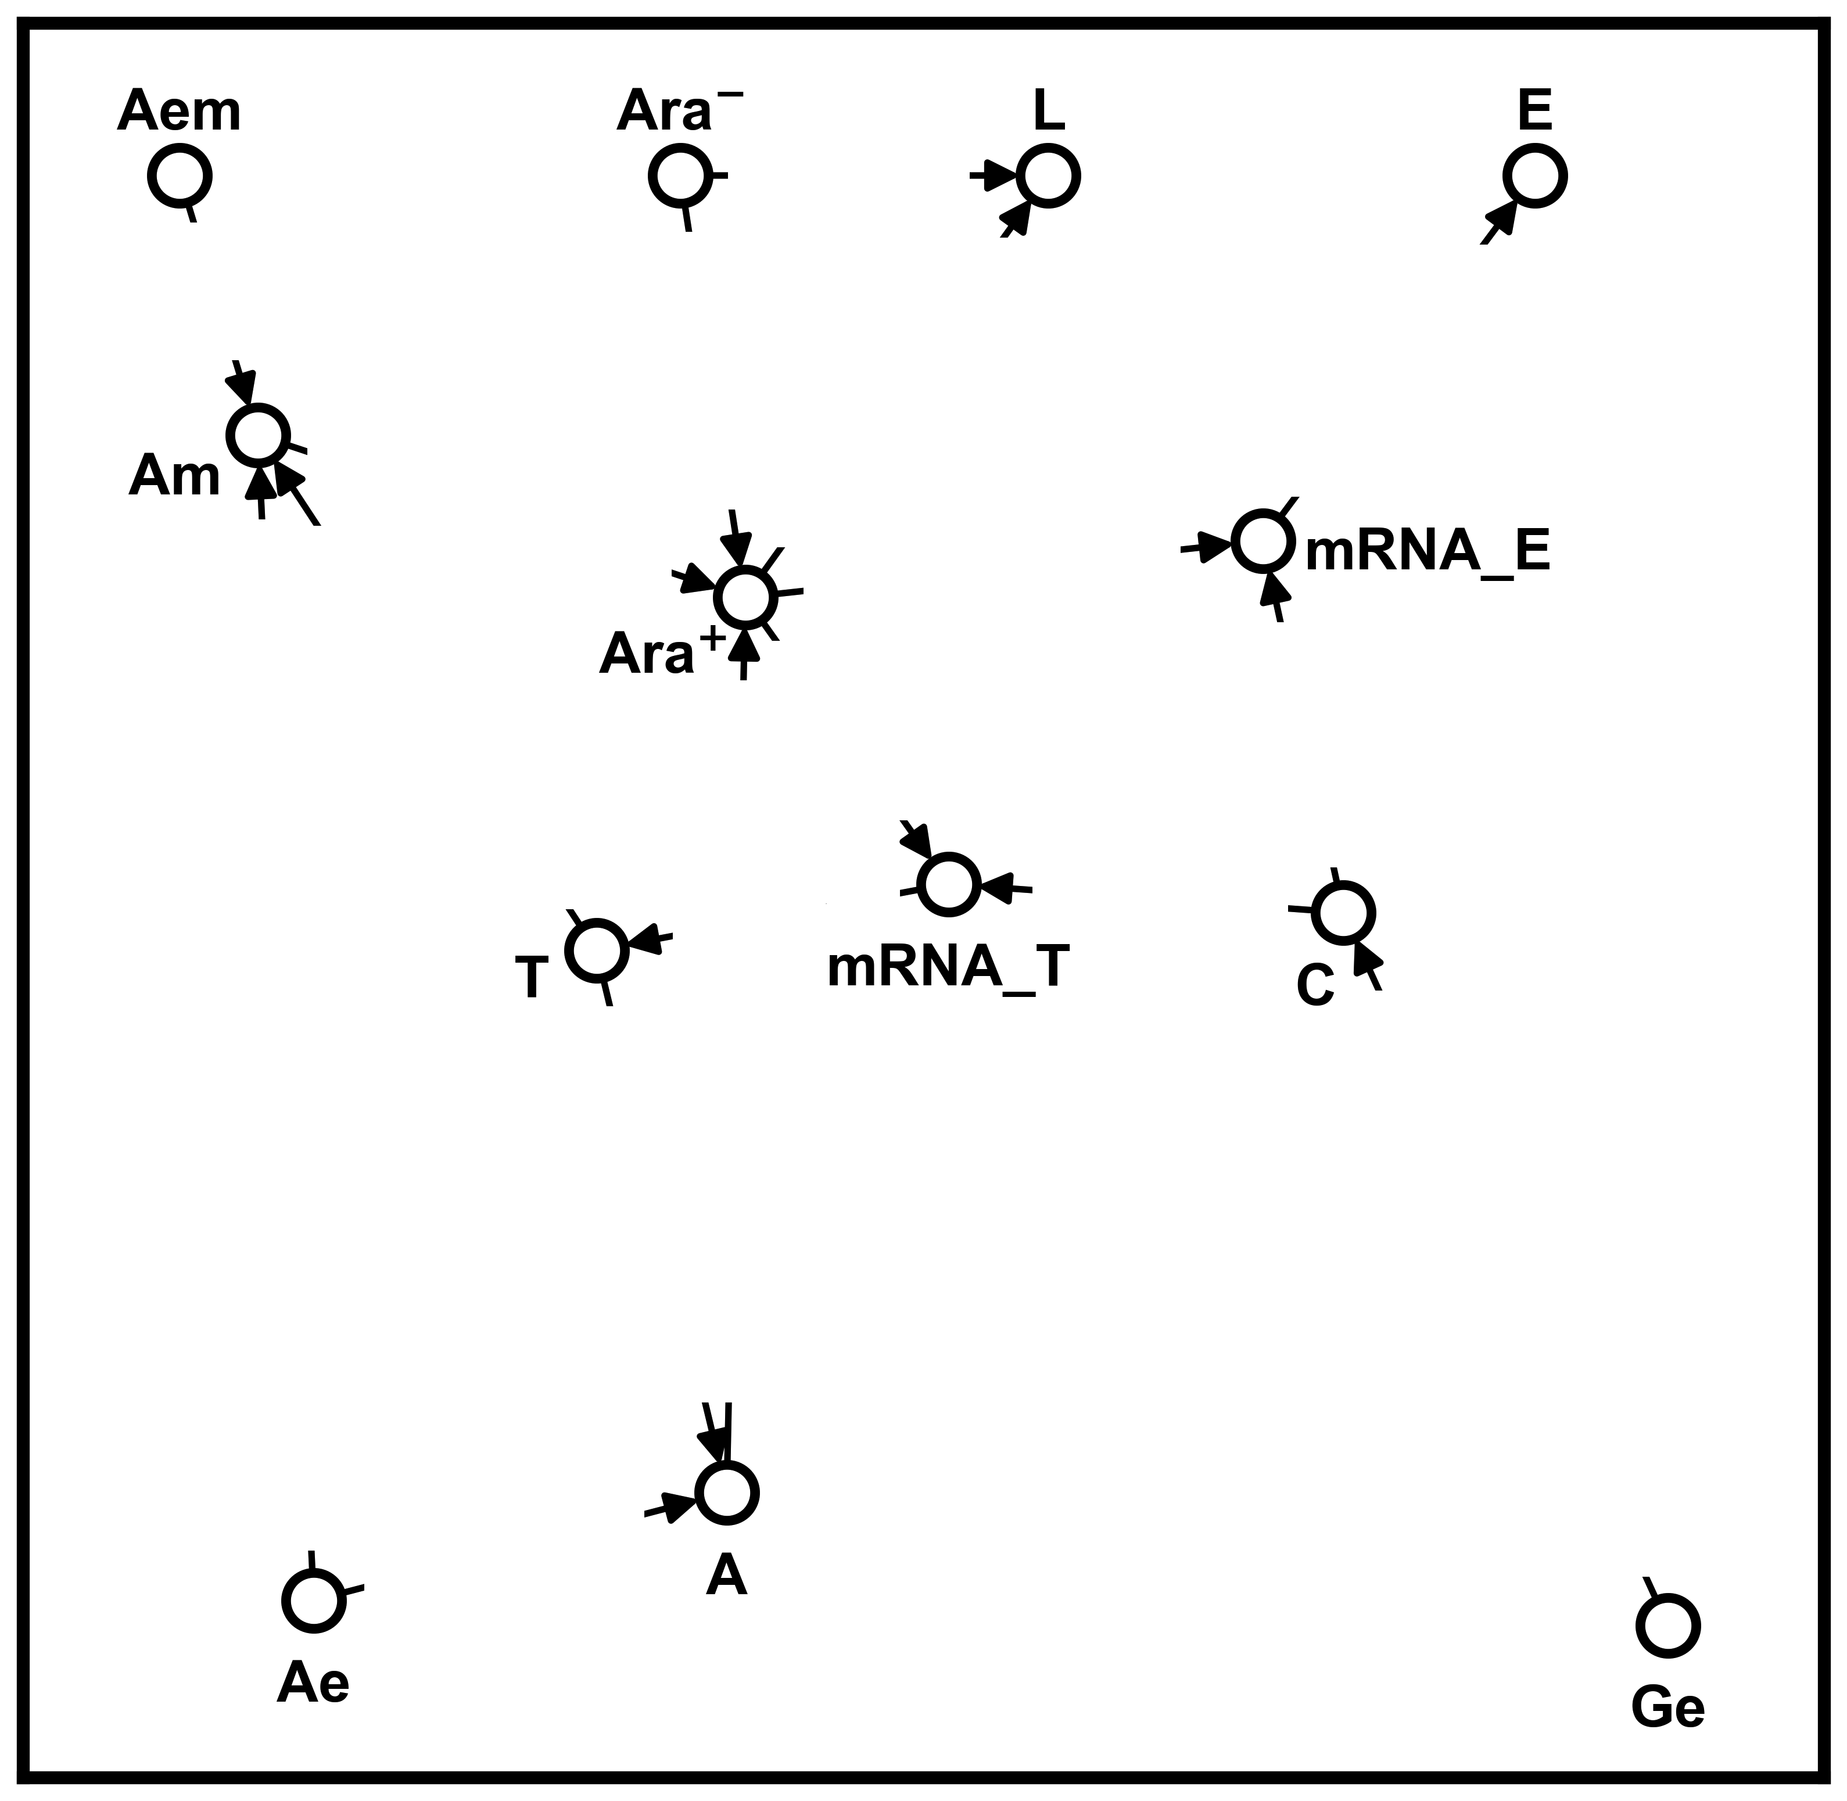
Generating random networks
Erase all arrows, but record in-degrees and out-degrees at each node
Randomly draw new arrows
Generate random Boolean function at each node

Slide 10
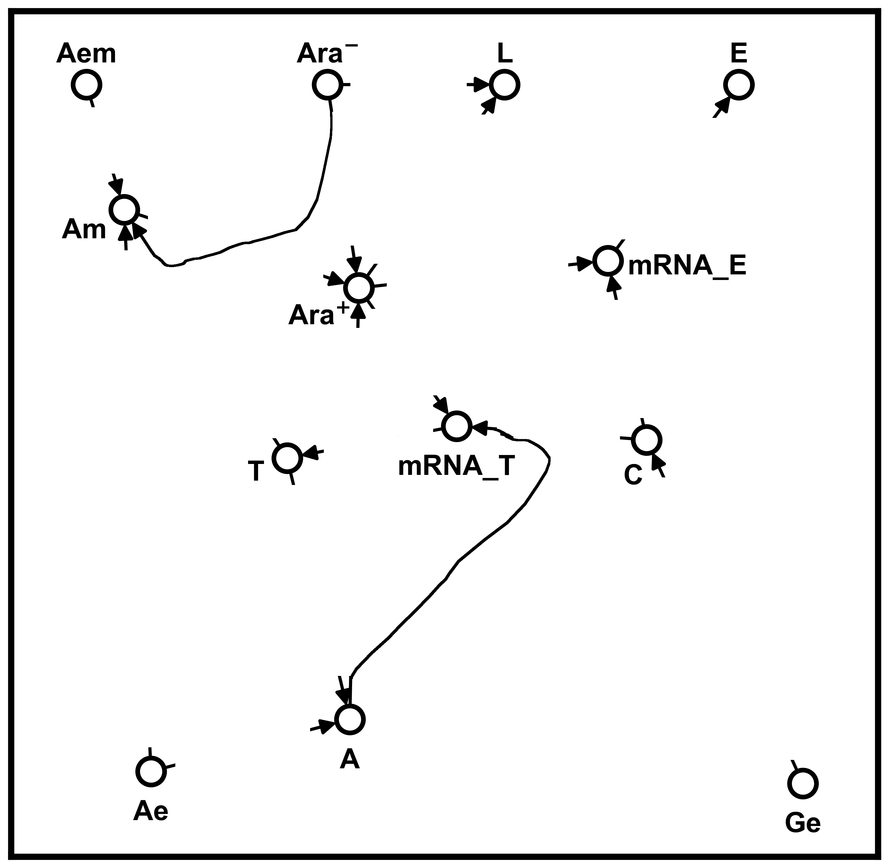
Generating random networks
Erase all arrows, but record in-degrees and out-degrees at each node
Randomly draw new arrows
Generate random Boolean function at each node

Slide 11
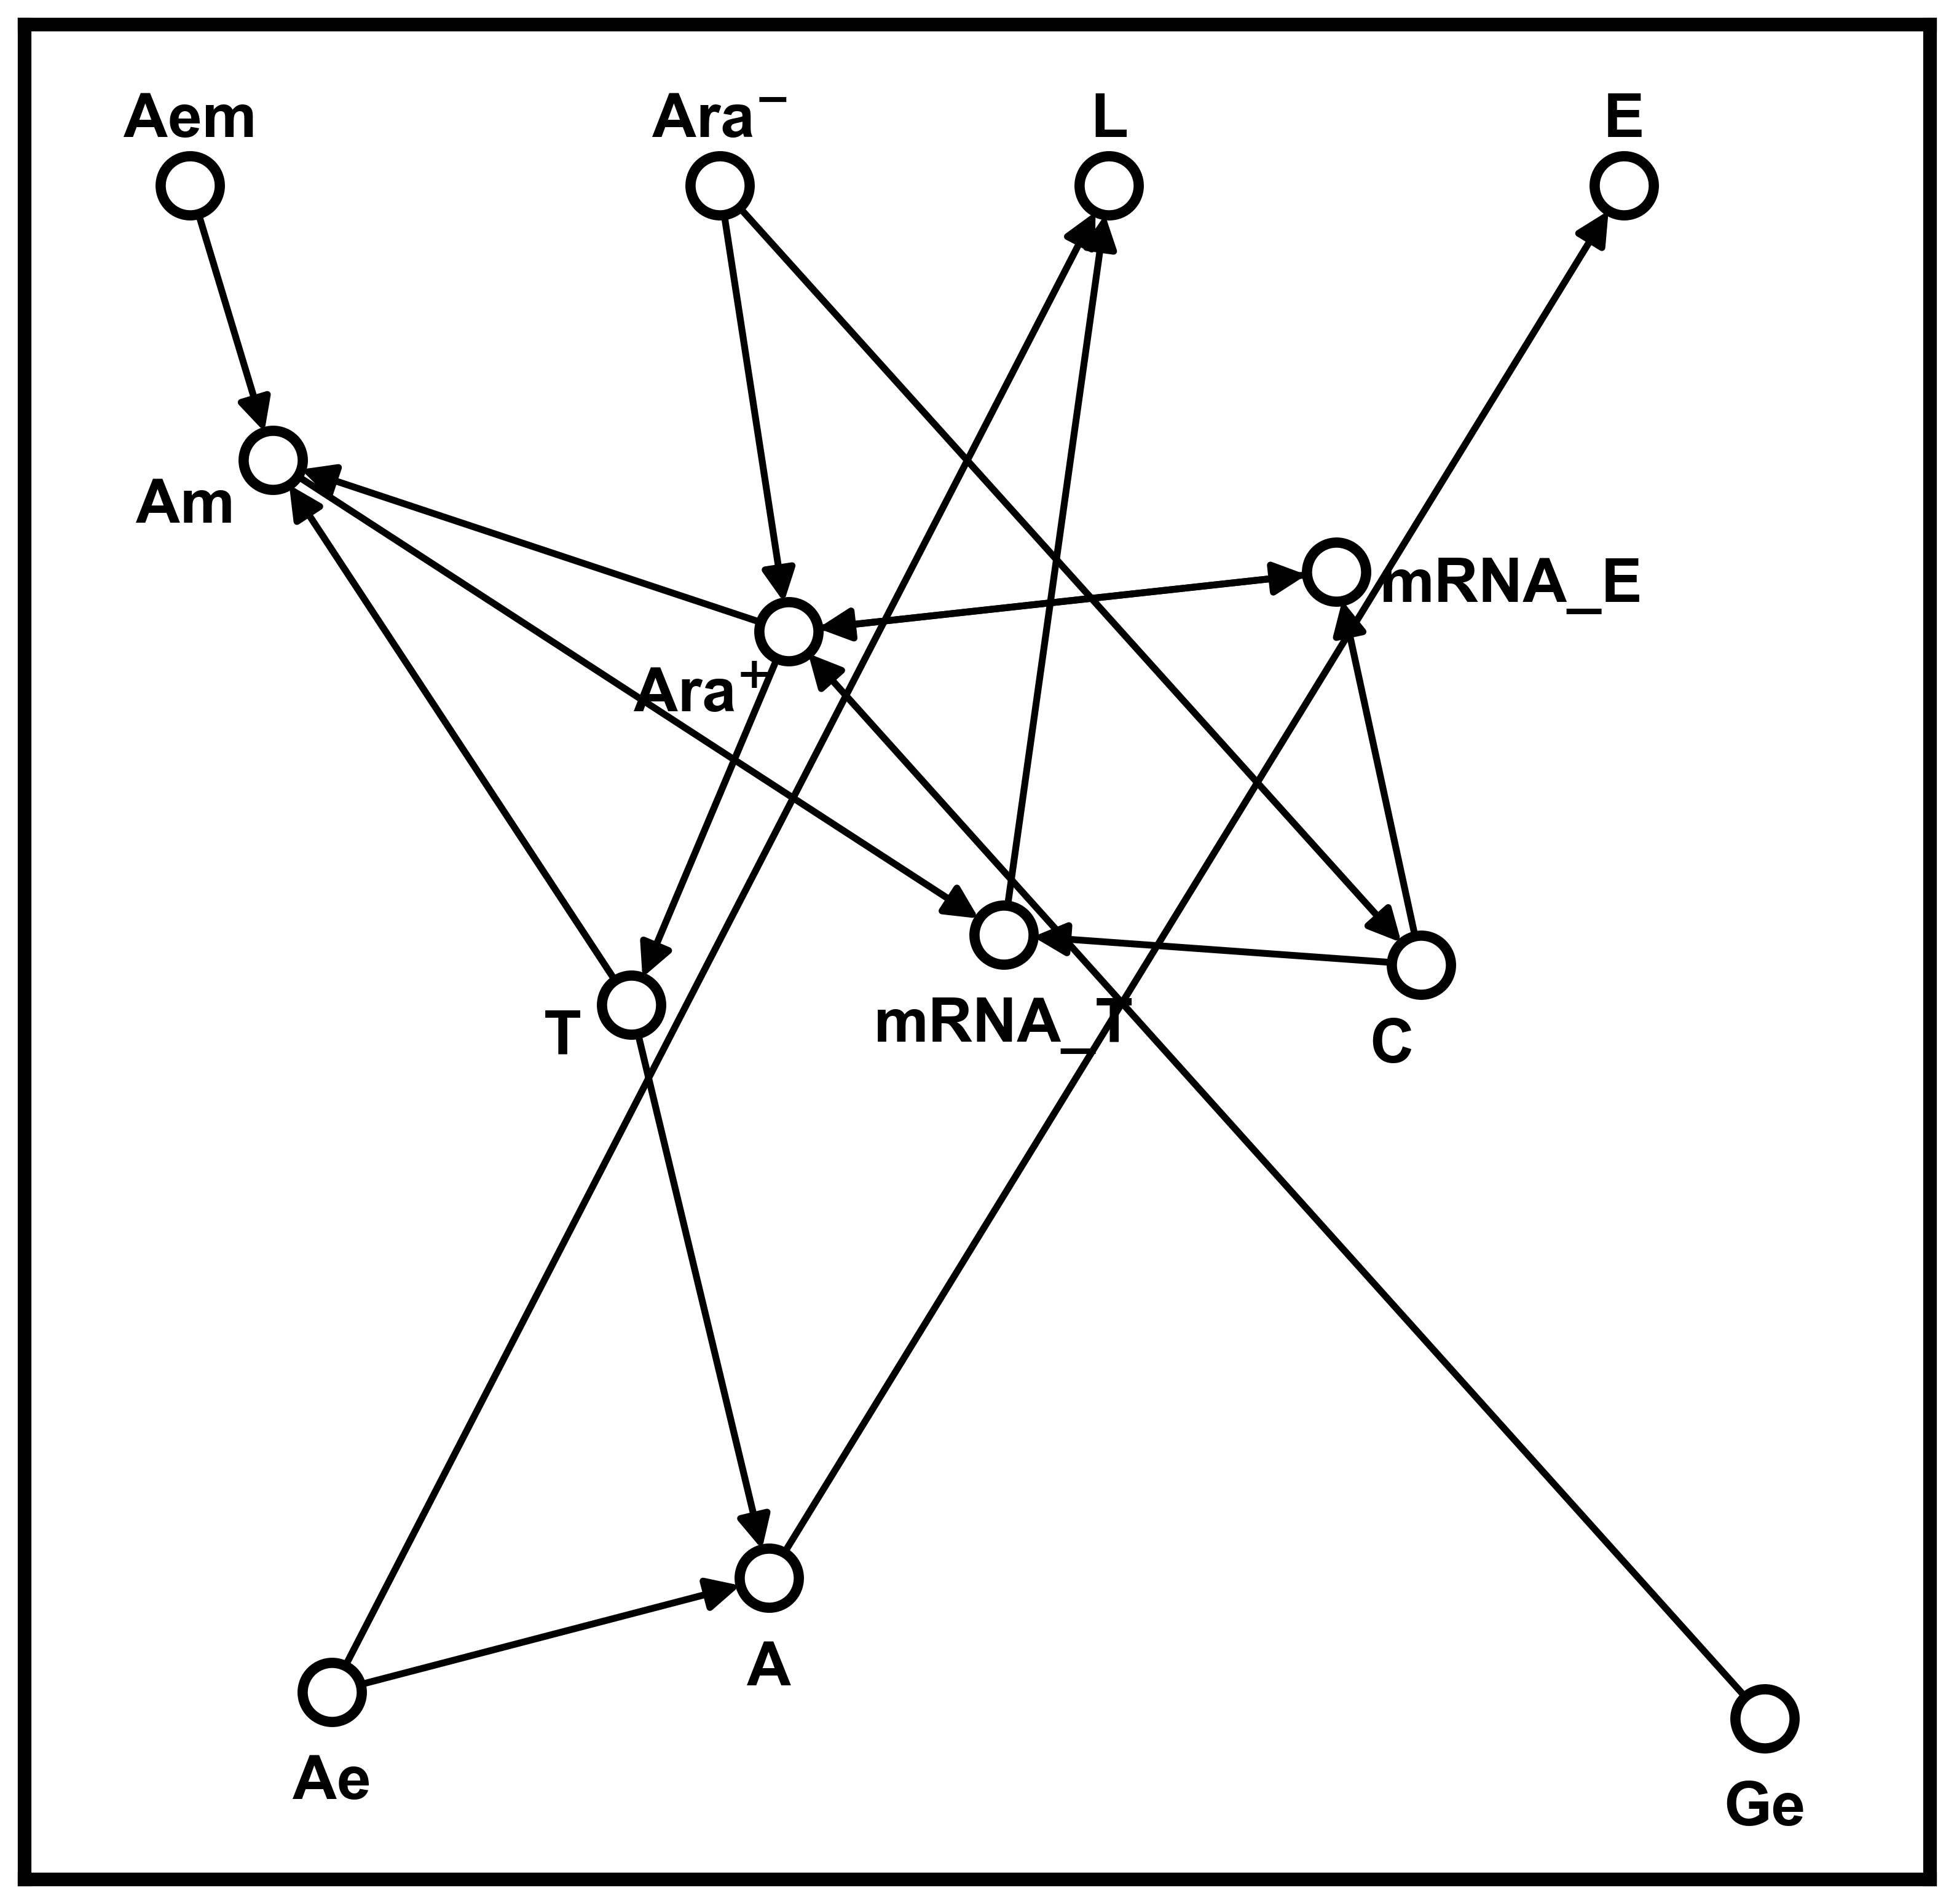
Generating random networks
Erase all arrows, but record in-degrees and out-degrees at each node
Randomly draw new arrows
Generate random Boolean function at each node

Slide 12
Generating random networks
Erase all arrows, but record in-degrees and out-degrees at each node
Randomly draw new arrows
Generate random Boolean function at each node
Am = NOT (Aem OR (T AND Ara⁺))

Slide 13
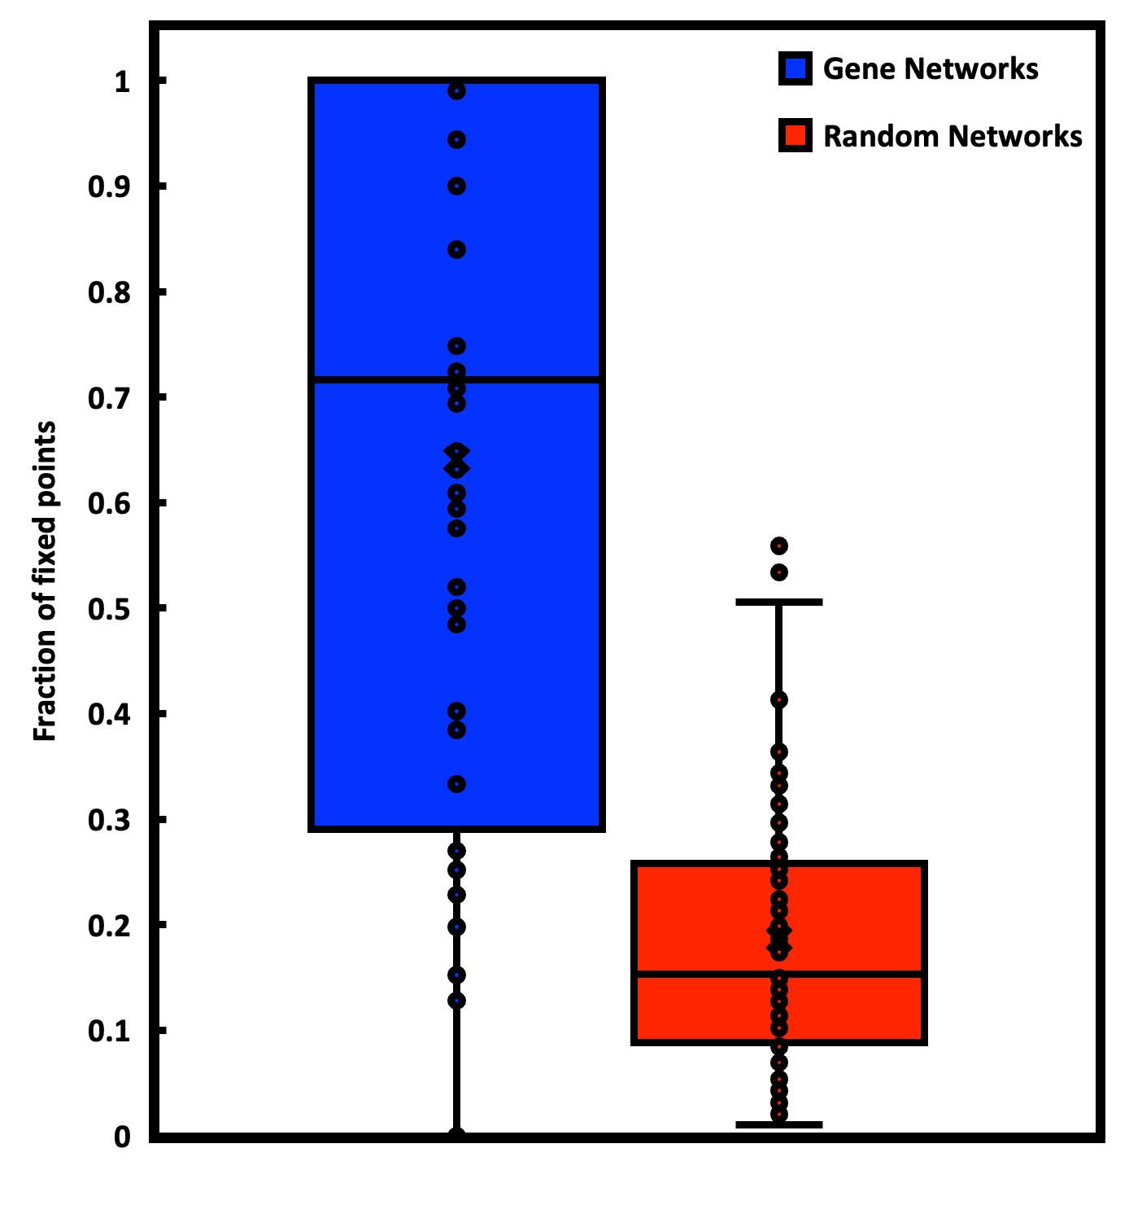
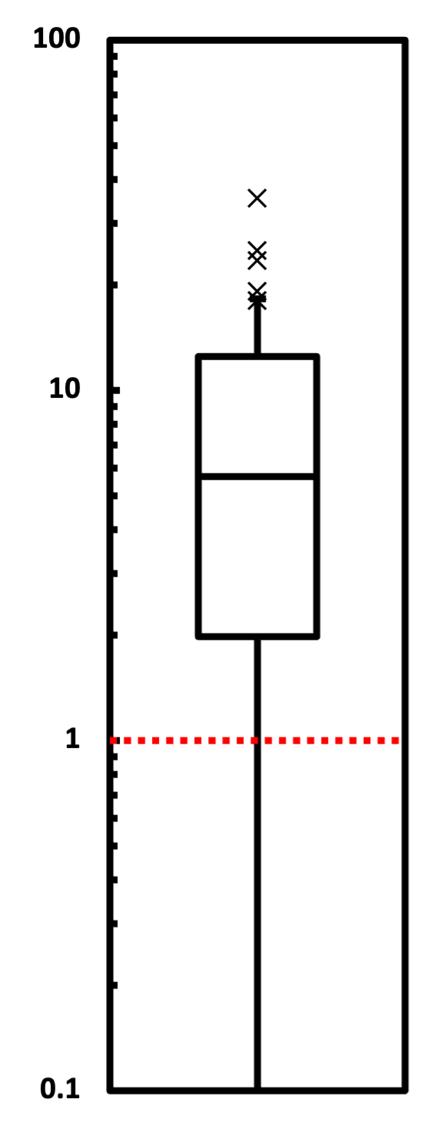
Fixed points are abundant in gene networks
Fold increase in fixed point abundance
Abundance of fixed points
Random networks are more unstable than real gene networks
Stability may be evolutionarily selected for across most gene networks
actual / random

Slide 14
Implications and future directions
For most gene networks, stability may confer a fitness advantage
If we delete a gene necessary for network stability, will cells re-evolve stability?
  If so, what are the time dynamics?
If we choose initial conditions close to each other, how do the systems evolve?

Slide 15
Questions?

Slide 16
Count fixed points and oscillators by running many simulations
Randomly generate initial conditions
Step network through time by updating each node using its Boolean function
Continue until we’ve visited the same state twice
Repeat 100,000 times

Slide 17
Generating random truth tables
Nodes can have up to 25+ inputs!
  Generating 2²⁵ bitstring inputs and Boolean outputs takes a long time
Instead, we store a list of row numbers where truth table output is 1 (the minterms)
Can then call prebuilt routine (Quine-McCluskey algorithm) to convert the list of minterms to a simplified Boolean expression

