Slide 1
Dynamics of Spatially Extended Populations
Chris Viets
M.I.T. Depts. of Physics and Biology

Slide 2
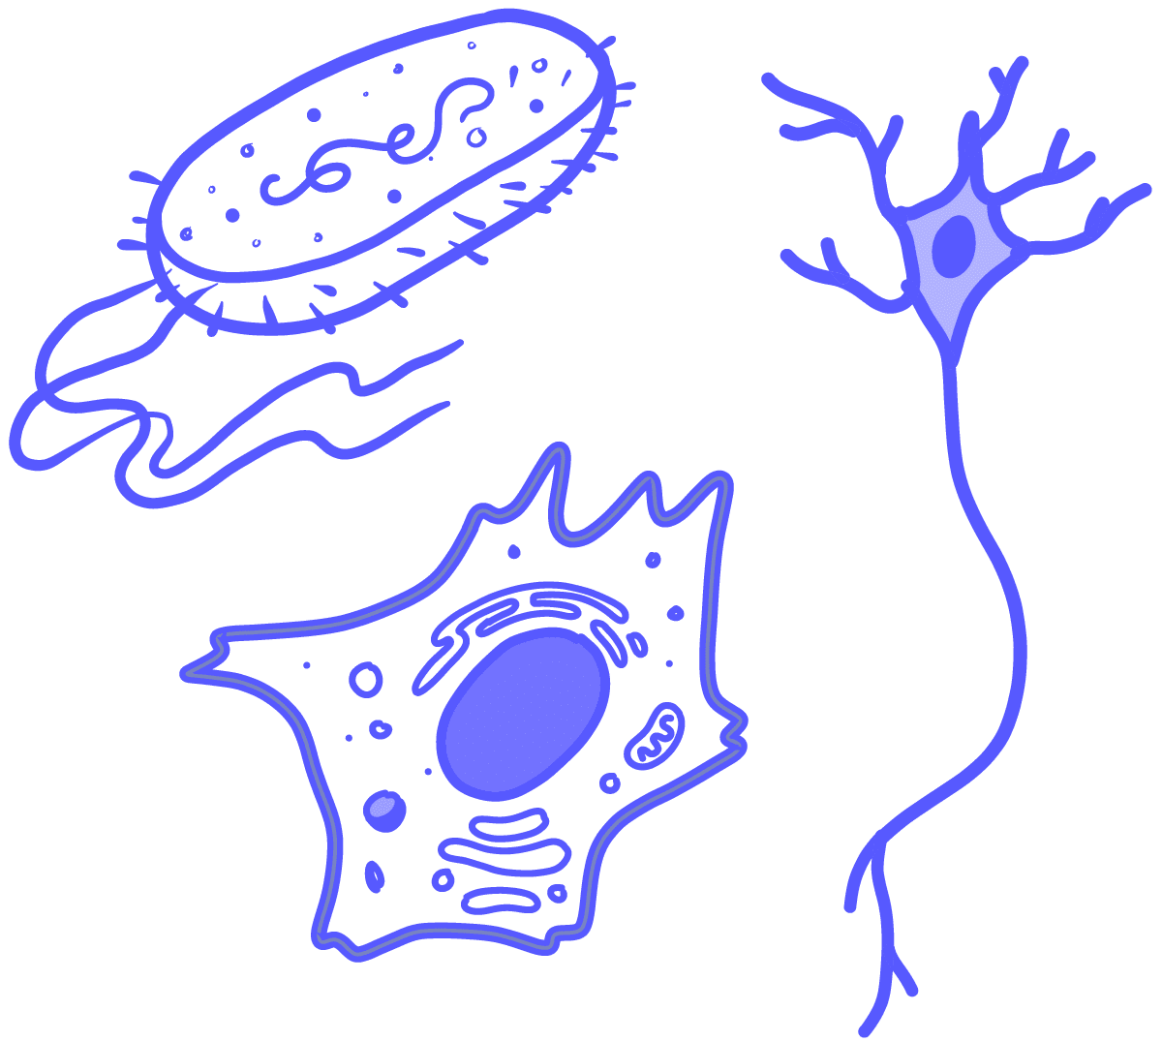
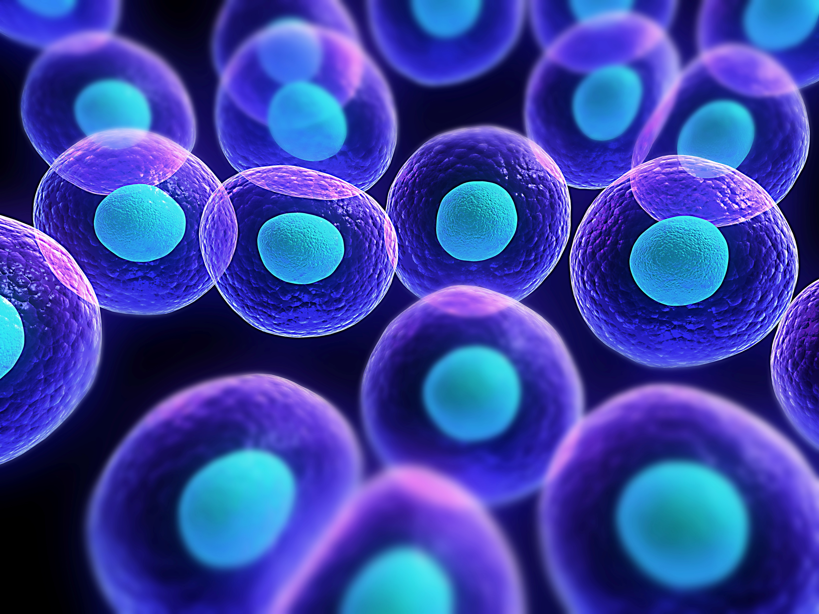
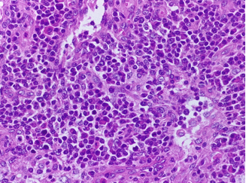
Motivation
How do we build a model of a spatially distributed population?
Why should physicists care?
Complex biological system → simpler, more general model

Slide 3
Dynamics depend on growth and migration
growth + migration

Slide 4
Dynamics depend on growth and migration
growth + migration
as

Slide 5
Dynamics depend on growth and migration
growth + migration
as

Slide 6
Building the migration term
+ migration

Slide 7
Building the migration term
+ migration
Conservation law:

Slide 8
Building the migration term
+ migration
Conservation law:

Slide 9
Building the migration term
+ migration
Conservation law:

Slide 10
Reaction-Diffusion Equation
reaction
diffusion

Slide 11
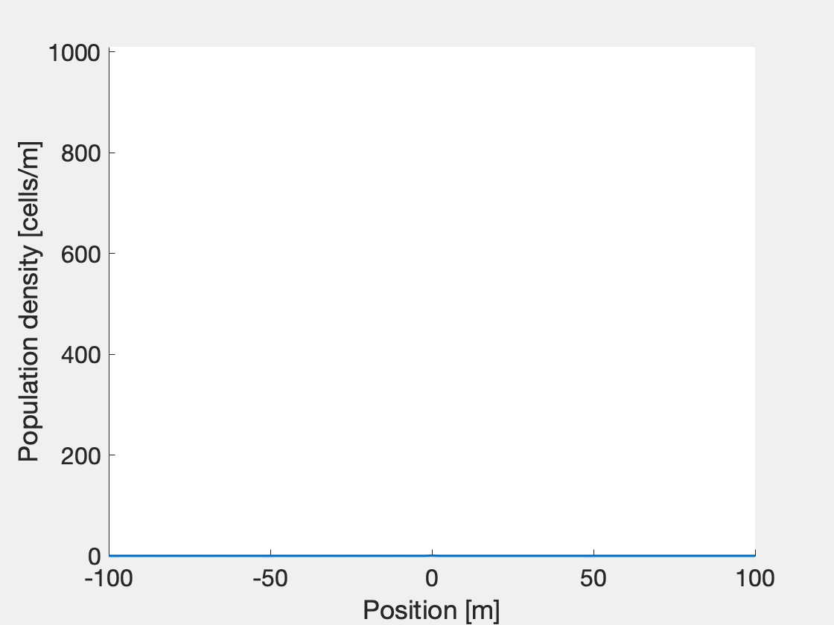
Reaction-diffusion equation produces traveling wave solutions
growth
migration

Slide 12
Chemotaxis: adding an attractive potential
In many cases, individuals tend to move up some gradient (e.g., food)
a = concentration of “food”/attractive chemical
growth + migration

Slide 13
Reaction-diffusion with chemotaxis
0

Slide 14
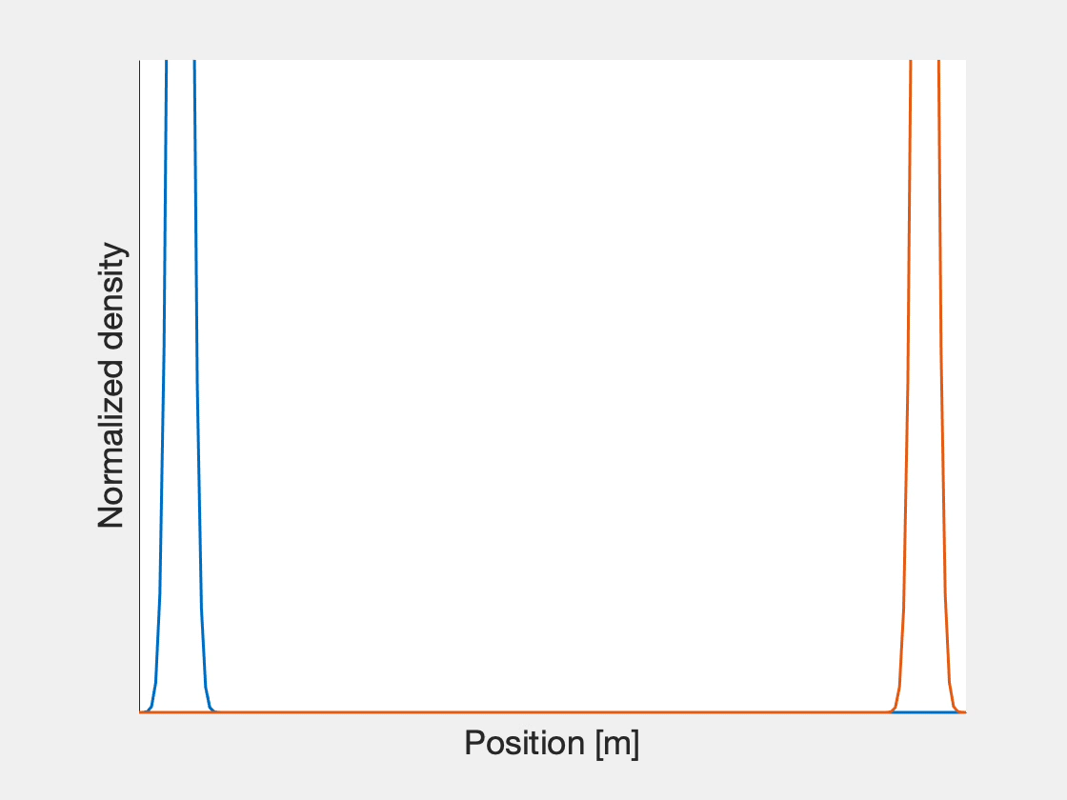
Example: Cells searching for food

Slide 15
Many applications elsewhere in physics!
Oxidation kinetics
Heat flow
Spatial population models
Physical chemistry
Fluid dynamics
Crystallography

Slide 16
Questions?

